Slide 1
Algorithms Design
and
Complexity Analysis

Slide 2
Algorithm
A well defined Sequence of statements which solves the problem logically
A well defined sequence of English statements can also be an algorithm
Algorithm does not belong to any particular language
A problem can have many algorithms
Algorithm always takes zero or more input and produces some desired output.
Solution Steps
(Algorithm)
DESIRED OUTPUT
INPUT

Slide 3
Properties of algorithms
Input: Zero or more quantities are supplied.
Definiteness: Each instruction of the algorithm should be clear and unambiguous.
Effectiveness: Statements should be basic enough, not very complex
Finiteness: The execution must be finished after finite number of steps
Output: Must provide desired output
An algorithm can be expressed in three ways:-
(i) In the form of pseudo code
(ii) In the form of a flowchart
(iii) In the form of a program in any specific programming language

Slide 4
Program Vs. Algorithm
A program is an implementation of an algorithm to be run on a specific computer.
An algorithm is a more abstract way to solve a problem; it does not deal with machine specific details.

Slide 5
Program Vs. Software
Computer Program :
A well defined set of instructions written in any programming language to perform some specific task.
Is Program itself a Software ?
NO, Program is small part of software.
A software generally comprises a group of programs (source codes), Documentation, Test cases, Input and Output Description etc.

Slide 6
Program design using algorithm
Problem
Analysis
Algorithm
Particular Language
Program
Two phase process –
Problem analysis:
Analyze and understand the user defined problem.
Write algorithm using basic algorithmic constructs.
2. Implementation:
Translate the algorithm into a desired programming language.

Slide 7
Sub-algorithm
A sub-algorithm is a part of another algorithm.
The relationship between an algorithm and a sub-algorithm is similar to the relationship between a main program (function) and a sub-program (sub-function) in a programming language.
When the problem is very complex, it is divided into several independent sub-problems. Each sub-problem can be solved independently using sub-algorithm.
The use of sub-algorithm allows efficient task management
John solves problem 1 and Mary solves problem 2
Whole project is not completely stopped if one of the smaller problems cannot be solved immediately.
Solve the other problems
Then research and solve the difficult part of the problem.
We may be able to reuse the solution to the smaller problem in another large problem
Sub-algorithms can be combined together to form the solution for the entire problem.

Slide 8
Approaches for designing algorithms
Greedy Approach –At each step, it selects the best possible solution.
A greedy algorithm, as the name suggests, always makes the choice that seems to be the best at that moment.
This means that it makes a locally-optimal choice in the hope that this choice will lead to a globally-optimal solution.
Examples:. Shortest path algorithm, Kruskal's algorithm and Prim's algorithm for finding minimum spanning trees.
Divide and Conquer –The divide and conquer approach involves the following steps at each level.
Divide − The original problem is divided into sub-problems.
Conquer − The sub-problems are solved recursively.
Combine − The solutions of the sub-problems are combined together to get the solution of the original problem.
Examples: Recursive Quick sort and merge sort etc.

Slide 9
Approaches for designing algorithms
Dynamic Programming (DP)- The approach of the Dynamic programming is similar to divide and conquer.
The difference is that for the recursive function calls with the same result, instead of calling them again, a DP approach tries to store the result in a data structure in the form of a table and retrieve the results from the table.
Thus, the overall time complexity can be reduced in DP.
Term “Dynamic” means this approach dynamically decides, whether to call a function or to retrieve the values from the table for solving a sub-problem.
Examples: 0-1 Knapsack, subset-sum problem, and recursive algorithm for Fibonacci Series are some examples of dynamic programming.

Slide 10
What is a Good Algorithm?
A good algorithm is an efficient algorithm
What is an efficient algorithm?
An efficient algorithm means which has small running time and also it takes less memory.
Hence, the time and space are two measures of efficiency for an algorithm.

Slide 11
Algorithm analysis
The goal of the analysis of algorithms is to compare algorithms (or solutions) mainly in terms of running time and memory requirement.
Assumption –
The algorithms to compared are correct.
The algorithm that probably takes lesser time is a better one, if the space requirement is constant.
Can you suggest any approach to compare the algorithms?
Approach 1: Empirical analysis (Experimental Study) approach–
Implement the algorithm into any programming language.
2. Run the program with inputs of varying size and compositions.
3. Use functions like clock() , System.currentTimeMillis(),etc. to get an accurate measure of the actual running time.

Slide 12
Limitations of Empirical analysis approach
Three basic Limitations:
It is necessary to implement the algorithm into a particular programming language , which may be a difficult or time consuming task.
Results may not be indicative of the running time on other inputs that are not included in the experiment.
To compare two algorithms, the same hardware and software environments must be used.

Slide 13
Approach 2: Asymptotic analysis approach
Method :
Develop a high level description of an algorithm.
From this high level description, count the number of primitive (basic) operations of the algorithm.
Advantages of this approach:
No need to implement algorithm on any system.
This approach considers all possible input instances as we consider the worst case
This approach also evaluate the efficiency of the algorithm which is independent of the platform we are using.

Slide 14
Constructs of algorithm
Identifying Numbers – Each statement can be assigned a identifying number.
Comment – Comment may be used to make algorithm easily readable and should not assigned any step number.
Variable – provide meaningful variable names
Input/output – For taking input from user Read / Input construct and for displaying /printing any message or any variable value Print/Write construct can be used.
Control Structure –a way to specify flow of control in algorithms
Mainly three types:
Sequential logic– Write numbered steps sequentially.
Selection logic – To select statement from many statements, If – else or its variations can be used.
Iteration logic – To repeat some statements, loops like while, for and do….while can be used.

Slide 15
Example: Find Largest Element in an array
Algorithm Find_Largest(x[], n)
1. let max = x[0]
2. for i = 1 to n-1
3. if x[i] > max then,
4. max = x[i]
5. Print max

Slide 16
Steps to analyze algorithms using approach 2
Primitive operations:
Assigning a value to a variables, like X=10, X=Y, etc.
Input output related operations, like Input, Display, Print.
Arithmetic and logical operations, Expression evaluation, like C=A+B*2
Control statements, like If-else, For, while,
Function and return statements, like Find_Fact(), return X.
First identify primitive (basic ) operations in the algorithm.
Count all corresponding primitive operations that are executed by an algorithm as follows:
a+b+b*c+(a+b)/(a-b) → one step;
comments → zero steps;
while (<expr>)→ step count equal to the number of times <expr> is executed.
for i=<expr> to <expr1> → step count equal to number of times <expr1> is checked.
3. Find the step count function or time complexity function in term of n by adding all the steps.

Slide 17
Time complexity: Example
 | Statements | Cost/Exec. | Freq. | Total
1. | Algorithm Sum(a[],n) | 0 | - | 0
2. | S = 0.0; | 1 | 1 | 1
3. | for i=1 to n do | 1 | n+1 | n+1
4. | s = s+a[i]; | 1 | n | n
5. | return s; | 1 | 1 | 1
2n+3
Hence, step count function or growth rate function f(n) =2n+3

Slide 18
Find largest: Elements arranged in Descending order
 | Statements | Cost/Exec. | Freq. | Total
1. | Algorithm Find_Largest(x[], n) | 0 | - | 0
2. | max = x[0] | 1 | 1 | 1
3. | for i = 1 to n-1 | 1 | n | n
4. | if x[i] > max then | 1 | n-1 | n-1
5. | max = x[i] | 1 | 0 | 0
6. | Print max | 1 | 1 | 1
2n + 1
Hence, step count function or growth rate function f(n) =2n+1

Slide 19
Find largest: Elements arranged in ascending order
 | Statements | Cost/Exec. | Freq. | Total
1. | Algorithm Find_Largest(x[], n) | 0 | - | 0
2. | max = x[0] | 1 | 1 | 1
3. | for i = 1 to n-1 | 1 | n | n
4. | if x[i] > max then | 1 | n-1 | n-1
5. | max = x[i] | 1 | n-1 | n-1
6. | Print max | 1 | 1 | 1
3n
Hence, step count function or growth rate function f(n) =3n

Slide 20
Time complexity: Example
Hence, step count function or growth rate function f=2rows*cols+2rows+1

Slide 21
Find the step count function
1 | Algorithm Sum(a[],n,m)
2 | {
3 | for i=1 to n do;
4 | for j=1 to m do
5 | s = s+a[i][j];
6 | return s;
7 | }

Slide 22
Time complexity: Example
 | Statements | C/E | Freq. | Total
1 | Algorithm Sum(a[],n,m) | 0 | - | 0
2 | { | 0 | - | 0
3 | for i=1 to n do; | 1 | n+1 | n+1
4 | for j=1 to m do | 1 | n(m+1) | n(m+1)
5 | s = s+a[i][j]; | 1 | nm | nm
6 | return s; | 1 | 1 | 1
7 | } | 0 | - | 0
2nm+2n+2
Hence, step count function or growth rate function f(n) = 2nm+2n+2

Slide 23
Time Complexity
Time complexity :Time requirement of an algorithm in terms of size of input.
In general, the time complexity of an algorithm can be analyzed in three cases:
Worst case
o Defines the input for which the algorithm takes maximum time.
o Input is the one for which the algorithm runs the slowest.
Best case
o Defines the input for which the algorithm takes least time.
o Input is the one for which the algorithm runs the fastest.
Average case
o Provides a prediction about the running time of the algorithm
o Assumes that the input is random

Slide 24
Conclusion
We have already seen that an algorithm can be represented in the form of an expression.
That means
Worst case
o Defines the input for which the algorithm takes huge time.
o Input is the one for which the algorithm runs the slowest.
Best case
o Defines the input for which the algorithm takes lowest time.
o Input is the one for which the algorithm runs the fastest.
Average case
o Provides a prediction about the running time of the algorithm
o Assumes that the input is random

Slide 25
Time Complexity
Simple step count functions can be compared easily.
Consider f(n) = (n² + 5), g(n)= log (n² + 1)
Which is better f(n) or g(n)?
Complex step count functions are difficult to compare.
Therefore, these step count functions can be simplified using some mathematical methods such as Big-O, Big-Omega etc.
For comparing, ‘rate of growth’ of step count function is easy and sufficient.
‘Rate of growth’ describes how the runtime will increase as the input size grows

Slide 26
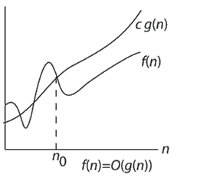
Asymptotic Notations
Asymptotic notation is a way of expressing the cost of an algorithm in terms of input size.
Goal of asymptotic notation is to simplify analysis by getting rid of unnecessary information
Big –O: Big-O of a function gives us ‘rate of growth’ of the step count function f(n), in terms of a simple function g(n), which is easy to compare.
Definition: for the given functions f(n) and g(n)
f(n)= O(g(n)) | if there exists positive constants c and n_{o} such that, 0<=f(n)<=cg(n) for all n>=n_{o}}
Defines a tight upper bound for a function.
f(n)= O(g(n)) implies that
g(n)grows at least as fast as f(n) or
f(n) is of the order at most g(n)

Slide 27
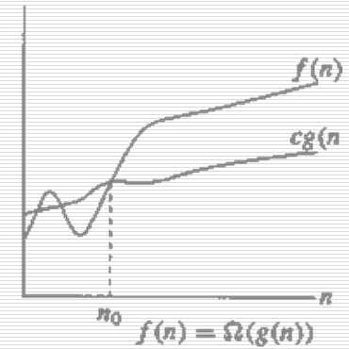
Asymptotic Notations (Cont…)
Big – Ω
Definition:
for the given functions f(n) and g(n)
f(n)= Ω (g(n)) | if there exists positive constants c and n_{o} such that, 0<=cg(n)<=f(n) for all n>=n_{o}}
Defines tight lower bound for a function
f(n)= Ω (g(n)) implies that
g(n) grows at most as fast as f(n) or
f(n) is of the order at least g(n)

Slide 28
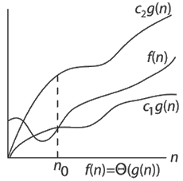
Asymptotic Notations (Cont…)
Big – θ
Definition:
for the given functions f(n) and g(n)
f(n)=θ(g(n)) | if there exists positive constants c1 and c2 and n_{o} such that, 0<=c1g(n)<=f(n)<=c2g(n) for all n>=n_{o}}
f(n)=θ(g(n)) iff f(n)=O(g(n)) and f(n)= Ω(g(n))
Defines tight lower bound and upper bound for a function, at the same time

Slide 29
Big –O Notation-Example 1
Given f(n) = 5n and g(n) = n then show that f (n)= O(g(n))
Solution:
Need to show that there exist two positive constants C and n_{o}
Such that 5n<=Cn for all n>= n_{o}
Clearly for C=5 above condition is true for all n>=1 (i.e. n_{o}=1)
Hence it is proved that f(n) = O(g(n))
Note : We could choose a larger values of C such as 6, however to make it tighter upper bound we usually try to find the smaller value.

Slide 30
Big –O Notation-Example 2
Show that f(n) = 4n + 5= O(n)
Solution: To show that f(n) = 4n + 5 = O(n), we need to produce a constants c and n_{o} such that: f(n) <= c * n for all n>= n_{o}
If we try c = 4, this doesn't work because 4n + 5 is not less than 4n.
We need c to be at least 9 to cover all n>=1. Hence [c, n_{o}]=[9,1]
Therefore, If n_{o} = 1, c has to be 9, but c can be smaller for greater values of n_{o} (if n_{o} = 100, c can be 5).

Slide 31
Big –O Notation-Example 3
If f(n) = n²: prove that f(n) ≠ O(n)
• To prove this, we must show that there cannot exist the constant c and n_{o} that satisfies the big-O definition.
This can be proved by contradiction.
Suppose there are two positive constants c and n_{o} that works; then, by the definition of big-O:
Supposition: n² ≤ c * n for all value of n>= n_{o}
• Suppose n is any positive real number greater than c,
then: n * n > c * n, or n² > c * n.
That means there exists a real number n such that n² > c * n.
This contradicts the supposition, so the supposition is false
There is no such C that can work for all n>= n_{o} :
f(n) ≠ O(n) where f(n) = n²

Slide 32
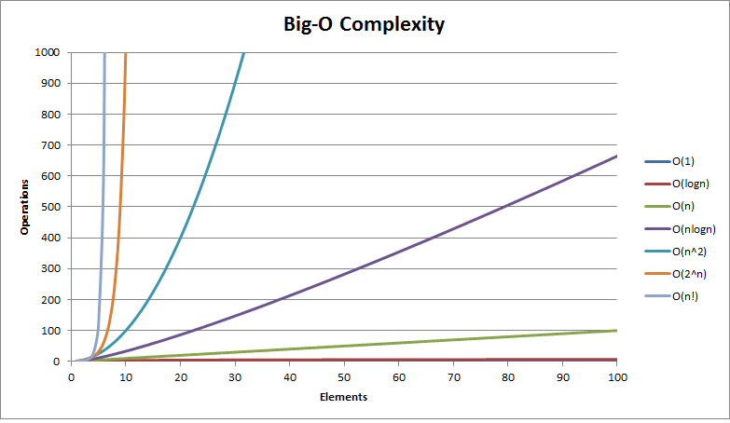
Big –O Notation

Slide 33
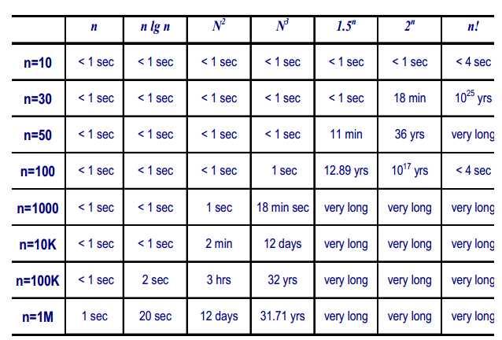
An interesting observation
Very long

Slide 34
Big –O Notation Example
>> Eg : 1. 3n + 2 = O(n) 3n + 2 ≤ 4n for all n ≥ 2.
So C=4 and n0=2 2. 3n + 3 = O(n) 3n + 3 ≤ 4n for all n ≥ 3.
So C=4 and n0=3 3. 100n + 6 = O(n) 100n + 6 ≤ 101n for all n ≥ 6.
So C=101 and n0=6

Slide 35
Worst Case Analysis (Usually Done)
In the worst case analysis, the upper bound on running time of an algorithm is calculated.
For the worst case analysis, we must know the case that causes maximum number of operations to be executed.
For Linear Search, the worst case happens when the element to be searched is not present in the array or it is present at the last location.
Therefore, the worst case time complexity of linear search is: O(n)

Slide 36
Big –Ω Notation Example
1. 3n + 2 = Ω(n) 3n + 2 ≥ 3n for all n ≥ 1.
So c=3 and n0=1
2. 3n + 3 = Ω(n) 3n + 3 ≥ 3n for all n ≥ 1.
So c=3 and n0=1
3. 100n + 6 = Ω(n) 100n + 6 ≥ 100n for all n ≥ 1.
So c=100 and n0=1

Slide 37
Best Case Analysis (Bogus)
In the best case analysis, lower bound on running time of an algorithm is calculated.
For the best case, we must know the case that causes minimum number of operations to be executed.
In the linear search problem, the best case occurs when the element to be searched is present at the first location.
The number of operations in the best case is constant (not dependent on n).
So time complexity of linear search in the best case would be O(1)

Slide 38
Big –θ Notation Example
1. 3n + 2 = Θ(n) 3n + 2 ≥ 3n for all n ≥ 2. 3n + 2 ≤ 4n for all n ≥ 2. So, C1 = 3, C2 =4 & n0 =2.

Slide 39
Average Case Analysis (Sometimes done)
In average case analysis, we take all possible inputs and calculate computing time for all of the inputs.
Sum all the calculated values and divide the sum by total number of inputs.

Slide 40
Basic asymptotic efficiency classes
1 | Constant
loglogn | double logarithmic
logn | Logarithmic
Log²n | log-squared
n | Linear
nlogn | Log linear
n² | Quadratic
n³ | Cubic
2^{n} | Exponential
n! | Factorial

Slide 41
Big-O Operations
Summation Rule:
O(f1(n) + f2(n)) = O(max(f1(n), f2(n)))
Example:
O(2^{n}+n³ )=
O(n⁴+nlogn)=O(n⁴)
Product Rule
Suppose T1(n) = O(f1(n)) and T2(n) = O(f2(n)). Then, we can conclude that
T1(n) * T2(n) = O(f1(n) * f2(n)).
Example:
O(n) * O (n²) * O (n³) = O (n⁶)
O(n²)*O(logn)=O(n²logn)
Note: For any two functions f(n) and g(n), we have f(n) = Θ(g(n)) if and only if f(n) = O(g(n)) and f(n) = Ω(g(n)).
O(2^{n})

Slide 42
Big-O Rules
If f(n) is a polynomial of degree d, then f(n) is O(n^{d}), i.e.,
Drop lower-order terms
Drop constant factors
Eg. f(n)=n⁶+3n²+77
Will be O(n⁶)
Use the smallest possible class of functions
Say “2n is O(n)” instead of “2n is O(n²)”
Use the simplest expression of the class(discard coefficient)
Say “3n + 5 is O(n)” instead of “3n + 5 is O(3n)”
Drop lower-order efficiency classes.
Example: f(n)=5000n⁶+3n²+77+34n!+nlogn
f(n)=O( )
n!

Slide 43
True or False
N² = O(N²)
2N = O(N²)
N = O(N²)
N² = O(N)
2N = O(N)
N = O(N)
true
true
true
false
true
true

Slide 44
True or False
N² = Ω(N²)
2N = Ω(N²)
N = Ω(N²)
N² = Ω(N)
2N = Ω(N)
N = Ω(N)
true
false
false
true
true
true

Slide 45
True or False
N² = Θ(N²)
2N = Θ(N²)
N = Θ(N²)
N² = Θ(N)
2N = Θ(N)
N = Θ(N)
true
false
false
false
true
true

Slide 46
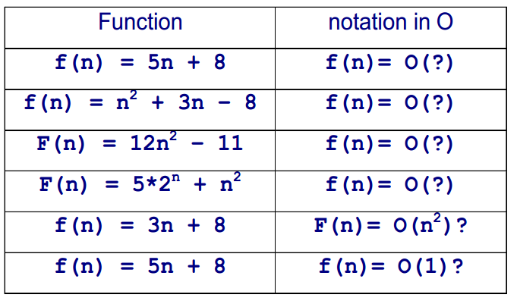
Big –O Notation Illustrations

Slide 47
Some tips to find out time complexity of algorithms
1) O(1): Time complexity of a function (or set of statements) is considered as O(1) if it doesn’t contain any loop, recursion and call to any other non-constant time function.
// set of non-recursive and non-loop statements
For example swap() function has O(1) time complexity. A loop or recursion that runs a constant number of times is also considered as O(1). For example the following loop is O(1).
// Here c is a constant
for (int i = 1; i <= c; i++)
{
// some O(1) expressions
}
Like
for (int i = 1; i <= 1000; i++)
{
Print i;
}
Example: Adding an element to the front of a linked list

Slide 48
Some tips to find out time complexity of algorithms
2) O(n): Time Complexity of a loop is considered as O(n) if the loop variables is incremented / decremented by a constant amount.
For example following functions have O(n) time complexity.
// Here c is a positive integer constant
for (int i = 1; i <= n; i += c)
{
// some O(1) expressions
}
for (int i = n; i > 0; i -= c)
{
// some O(1) expressions
}
Like
for (int i = 1; i <= n; i += 1)
{
Print i;
}
Example: linear search

Slide 49
Some tips to find out time complexity of algorithms
3) O(n^{c}): Time complexity of nested loops is equal to the number of times the innermost statement is executed.
For example the following sample loops have O(n²) time complexity
for (int i = 1; i <=n; i += c)
{
for (int j = 1; j <=n; j += c)
{
// some O(1) expressions
}
}
For (i = n; i > 0; i -= c) {
for (int j = i+1; j <=n; j += c)
{ // some O(1) expressions
}
For example Selection sort and Insertion Sort have O(n²) time complexity.

Slide 50
Some tips to find out time complexity of algorithms
4) O(Logn) Time Complexity of a loop is considered as O(Logn) if the loop variables is divided / multiplied by a constant amount.
for (int i = 1; i <=n; i *= c)
{
// some O(1) expressions
}
for (int i = n; i > 0; i /= c)
{
// some O(1) expressions
}
Like
for (int i = 1; i <=n; i *= 2)
{
// some O(1) expressions
}
For example Binary Search has O(Logn) time complexity.

Slide 51
Some tips to find out time complexity of algorithms
5) O(LogLogn) Time Complexity of a loop is considered as O(LogLogn) if the loop variables is reduced / increased exponentially by a constant amount.
// Here c is a constant greater than 1
for (int i = 2; i <=n; i = pow(i, c))
{
// some O(1) expressions
}
//Here fun is sqrt or cuberoot or any other constant root
for (int i = n; i > 0; i = fun(i))
{
// some O(1) expressions
}
Like
for (int i = 2; i <=n; i = i²)
{
// some O(1) expressions
}

Slide 52
How to combine time complexities of consecutive loops?
When there are consecutive loops, we calculate time complexity as sum of time complexities of individual loops.
for (int i = 1; i <=m; i += c)
{
// some O(1) expressions
}
for (int i = 1; i <=n; i += c)
{ // some O(1) expressions
}
Time complexity of above code is O(m) + O(n) which is O(m+n)
If m == n, the time complexity becomes O(2n) which is O(n).

Slide 53
Find the growth rate function and Time Complexity
x = x +1; //constant time
for (i=1; i<=n; i++)
{
m = m + 2; //constant time
}
for (i=1; i<=n; i++) //outer loop executed n times
{
for (j=1; j<=n; j++) //inner loop executed n times
{
k = k+1; //constant time
}
}

Slide 54
Homework
Q1. Rank the following function by their order of growth(increasing order).
(n+1)! , 1 , n^{1/lgn} , (3/2)^{n} , log(log n) , sqrt(2)^{lg n} , (lg n)^{lg n} , sqrt(lg n)
Q2. Analyse the following fragments of code. Formulate exact expressions for the running time of each code fragment.
(a)
int sum = 0;
int num = 35;
for (int i=1; i<=n; i++) {
for (int j=1; j<=n; j++) {
num += j*3;
sum += num;
}
}
(b)
int count = 0;
for (int i = n; i > 0; i /= 2)
for (int j = 0; j < i; j++)
count += 1;
(b)
for ( i=0 ; i < n ; i++ ) total = total + i;
for ( j=0 ; j < n ; j++ ) total = total + j;
(d)
int count = 0;
for (int i = 0; i < n; i++)
for (int j = i; j > 0; j--)
count = count + 1;

